Slide 1
Leaving your Legacy Rev. Karl Biermann, Regional Gift Planner

Slide 2
Dwelling in the Word
Notes:
Dwelling in the word is a simple practice of engaging and discovering God’s word together. It’s a pretty simple process but it’s one in which we invite the Spirit to help us speak and hear God’s word.
I will ask a volunteer to read the scripture out load.
We will have a moment of silence for everyone to re-read the scripture and reflect on God’s word.
I invite you to turn to another person (may have one group of three IF NEEDED.) Share with the other person word or phrase stood out in the scripture and why.
After a a few moments we will invite each pair to share back with the group what they heard. We will do this by having each of you share WHAT YOU HEARD FROM THE OTHER PERSON.
Any questions?

Slide 3
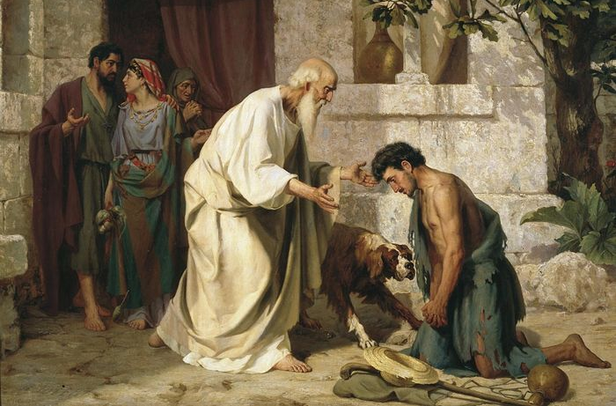
Prodigal Son - Luke 15:11–32

Slide 4
An Estate Plan: Sharing Wealth
Relationships
Values
Resources

Slide 5
Statistics on personal inheritance
It takes the average recipient of an inheritance 19 days until they buy a new car.
3 Years – 33% of heirs will have negative savings
5 Years - The average inheritance will be gone.
70% of wealthy families lose their wealth by the second generation.
90% of wealthy families have lost their wealth by the third
78% feel the next generation is not financially responsible enough to handle inheritance.
64% admit they have disclosed little to nothing about their wealth to their children.

Slide 6
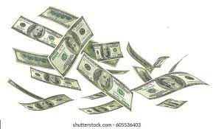
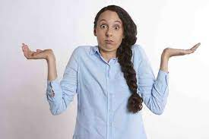
Family Challenges

Slide 7
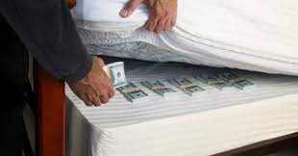
Charitable Challenges

Slide 8
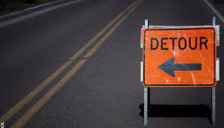
Charitable Challenges

Slide 9
Clear process with clear outcomes
Discovery
Relationship, Values, Resources
Giving Options
Review of current plan
Gift Implementation
Next steps w/ other professionals
What are your goals?
Discussion of potential options
Communication plan with family

Slide 10
From This
Notes:
My role is to help you quickly develop clarity. I want to use this as an example.
Can anyone quickly tell me how to get from Willis Tower in Chicago to the Churchwide office?

Slide 11
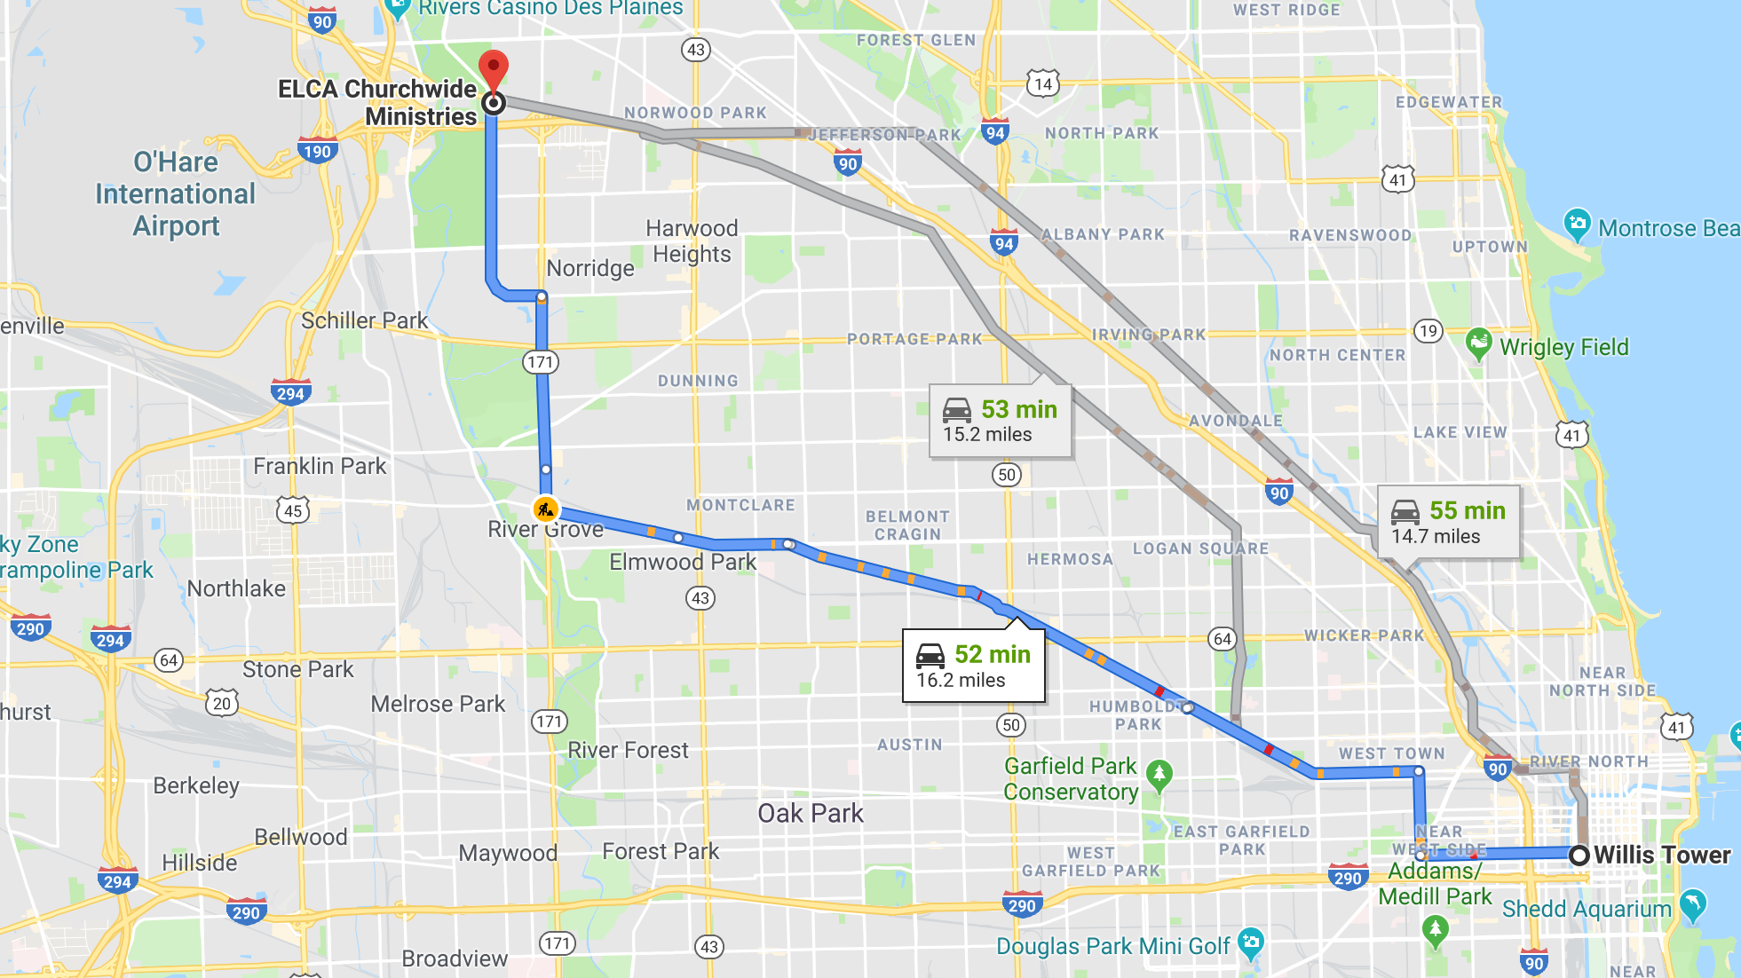
To This
Notes:
What about now?

Slide 12
To clear next steps!
Notes:
And what about now?
My work is designed to lay out a clear, concise and proven process so that the next step has absolute clarity for you!

Slide 13
Donor Work – Informed Legacy Giving
Financial Planner
Attorney
CPA
Charitable Advisor

Slide 14
Family Farm
Notes:
Share the story of the Svensen farm or another real estate gift.

Slide 15
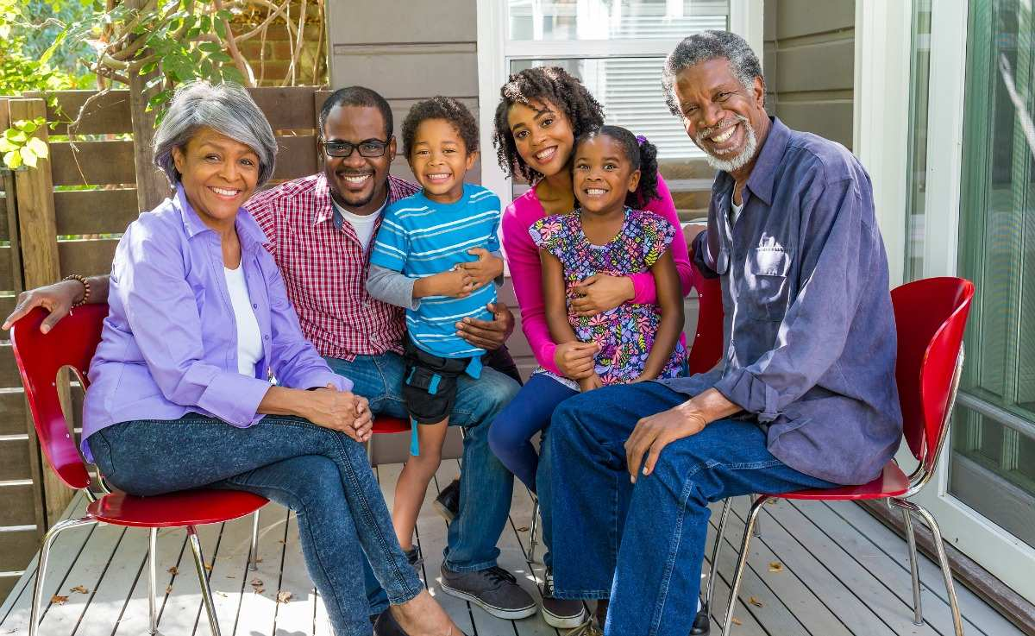
Family Estate
Notes:
Share the story of a family estate you worked on and how they were so happy to know their kids were taken care of and that they could support the charities they love and care for.

Slide 16
Desired Outcomes
Understanding of family vision, values and goals.
Reflection on your resources and calling.
Options for consultation with other professions.
Clear communication points about your plans.

Slide 17
Questions

Slide 18
Start your plan. Contact your regional gift planner.
Rev. Karl Biermann karl.biermann@elca.org 330-612-4174 Cell phone and Office
Notes:
Cover obstacles… procrastination, too much… too little… too complicated

